Slide 1
S1
© Copyright 2018, Los Angeles County.
All Rights Reserved.

Slide 2
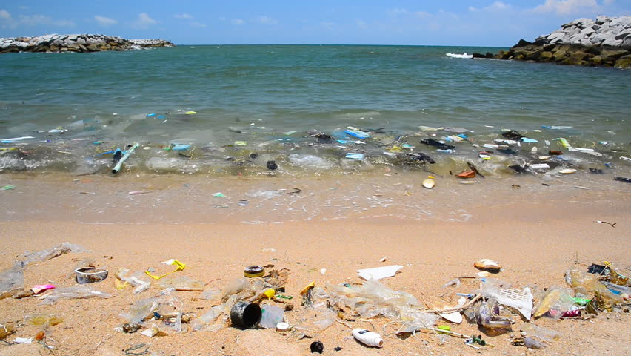
WHAT IS WRONG WITH THIS PICTURE?
S2
https://www.shutterstock.com/video/clip-9500465-stock-footage-pollution-on-the-beach-of-tropical-sea.html?src=rel/13104191:1/gg

Slide 3
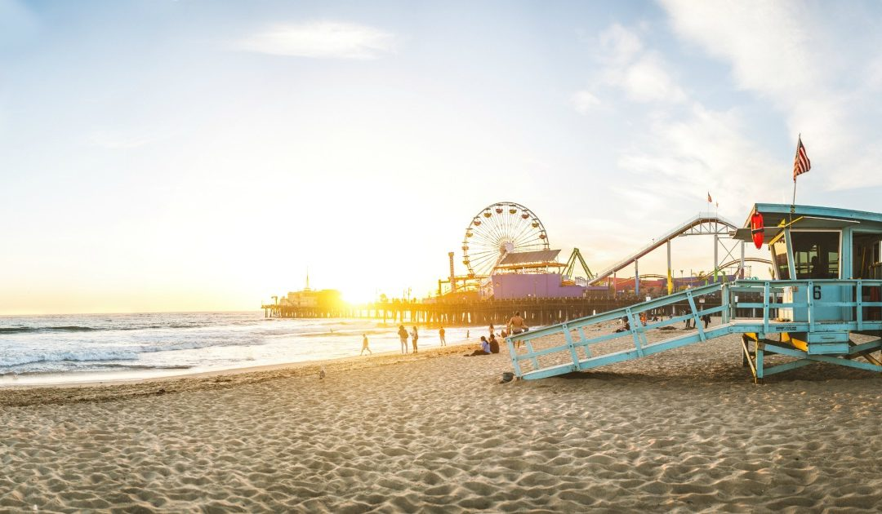
S3
HOW SHOULD A BEACH LOOK?
https://www.shutterstock.com/video/clip-9500465-stock-footage-pollution-on-the-beach-of-tropical-sea.html?src=rel/13104191:1/gg
https://supervisorkuehl.com/wp-content/uploads/2017/06/Heal-the-Bay-Report-Card-1080x630.jpg

Slide 4
S4
WHO MADE ALL THIS WASTE AND
HOW DO YOU THINK IT ENDED UP AT THE BEACH?
Chart student responses
Who?
How?

Slide 5
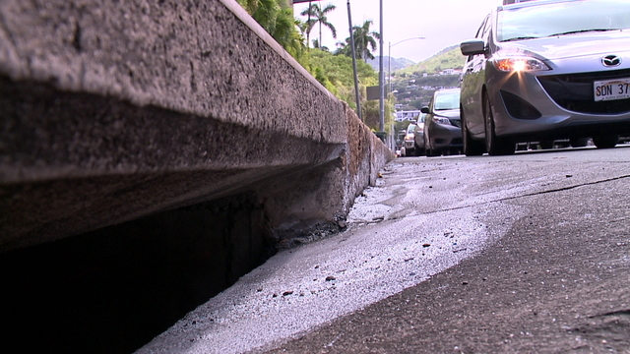
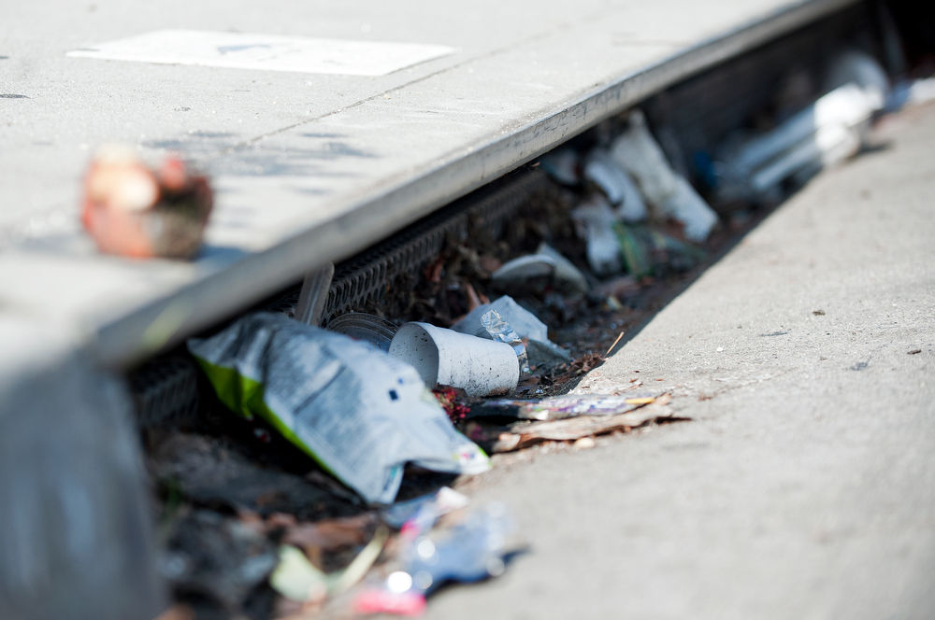
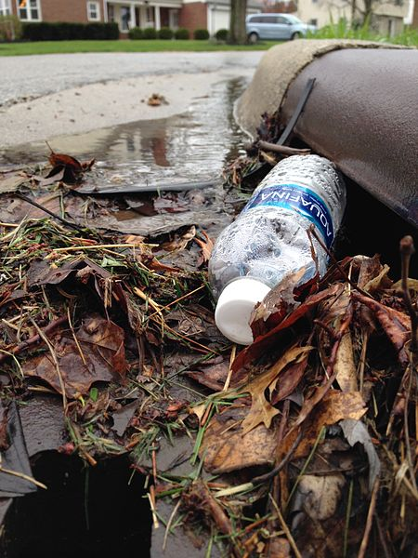
S5
https://www.khon2.com/news/local-news/contractor-caught-dumping-waste-water-down-storm-drain/1025784152
https://www.scpr.org/news/2018/07/17/84816/l-a-county-voters-to-decide-on-new-stormwater-tax/
WHAT ARE POLLUTANTS?
Any substances that can hurt the environment.
WHAT IS STORMWATER POLLUTION?
Excess water that runs down storm drains
carrying pollutants from the environment.
https://commons.wikimedia.org/wiki/File:%22I_prefer_the_bottled_stuff,%22_said_the_storm_drain._(25565964563).jpg

Slide 6
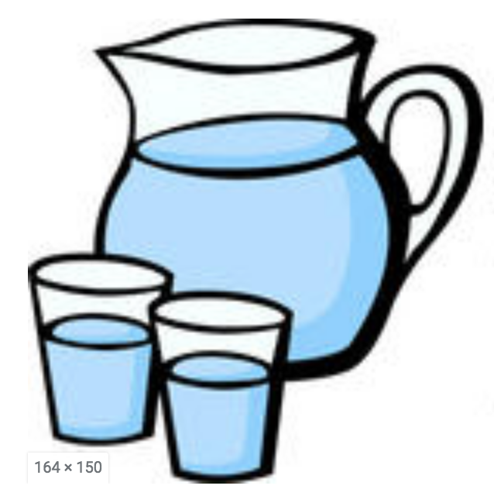
Where does our water come from?
S6
http://www.clipartguide.com/_pages/0511-0901-0516-4420.html
https://www.istockphoto.com/vector/water-tap-clip-art-cartoon-illustration-gm186932652-27058811
http://realclipart.today/clip-art-of-glasses-of-water.html
https://vectortoons.com/product/a-black-woman-taking-out-her-washed-linens-from-the-washer/

Slide 7
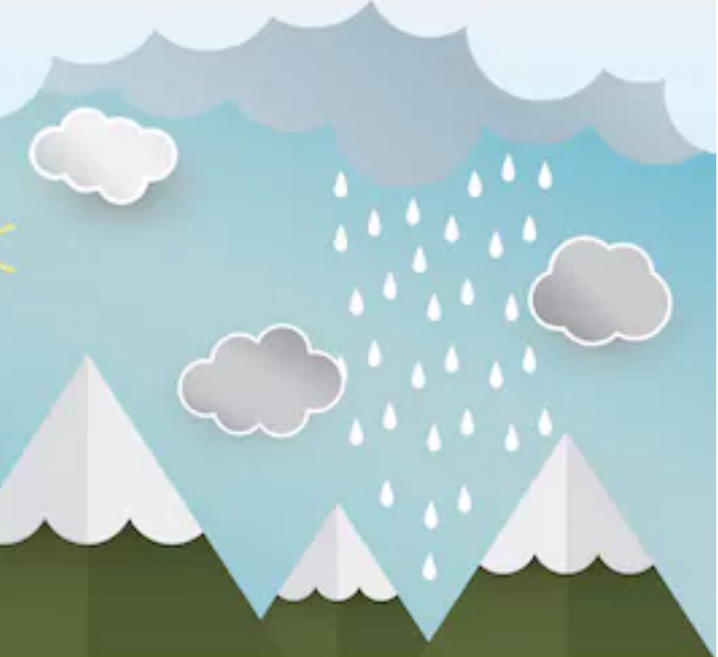
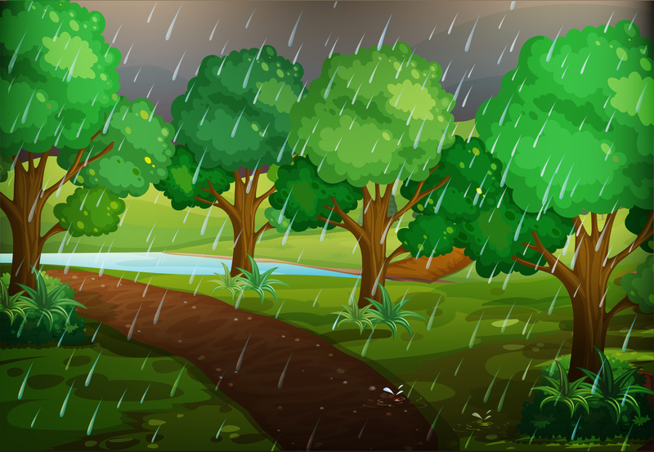
What happens to the rainwater on the ground? Where does it go?
S7
https://www.shutterstock.com/image-vector/paper-art-rain-sun-mountain-cloud-655089091
https://www.dreamstime.com/illustration/forest-scene-rainy-day.html
https://www.dreamstime.com/royalty-free-stock-photos-rain-city-image23524878#res170862

Slide 8
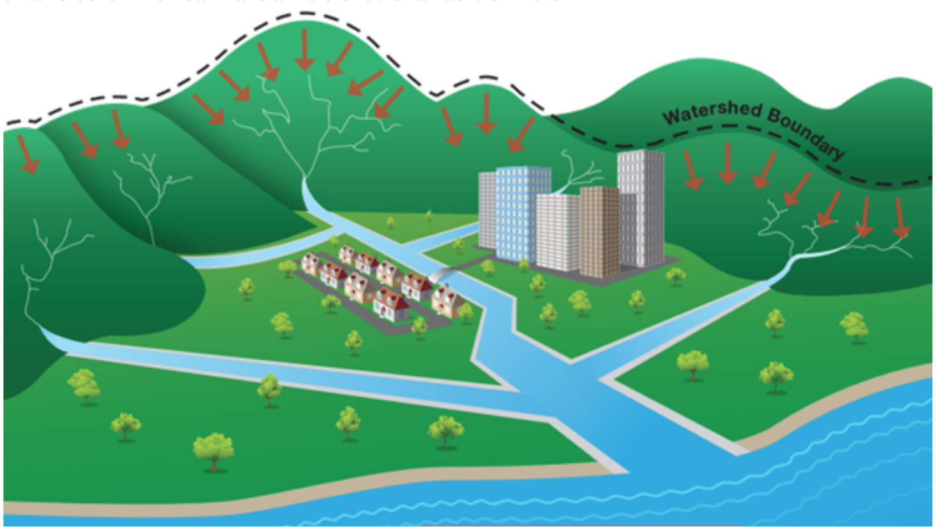
WHAT IS A WATERSHED?
S8
A watershed is an area
of land that contains a
group of streams and
rivers that all drain into
a single body of water,
such as a larger river,
a lake, or an ocean.
http://www.lastormwater.org/about-us/about-watersheds/

Slide 9
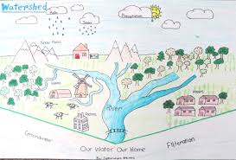
S9
INITIAL WATERSHED MODEL
In your Science Notebook, draw a model of the watershed we just observed.
Remember to add labels.
http://www.capeatlantic.org/Poster_Contest_.html

Slide 10
S10
RAINWATER IN A WATERSHED MODEL
Add arrows in your watershed model that show the direction the rain water flowed through the watershed.

Slide 11
S11
RAINWATER IN A WATERSHED MODEL
Answer the following questions under your model:
Where does our water come from?
What is a watershed?
When it rains, where does the rainwater go?

Slide 12
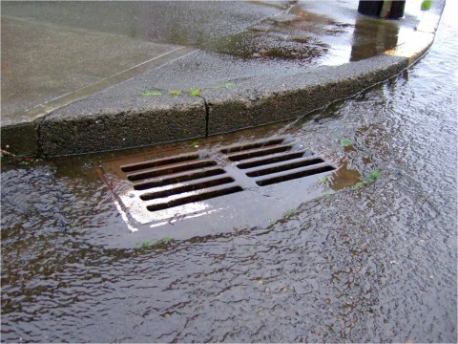
S12
RAINWATER IN CITY STREETS
When it rains in the streets around your house, where does the water go?
http://www.duncanville.com/departments/public-works/divisions/stormwater/street-stormwater-drain/

Slide 13
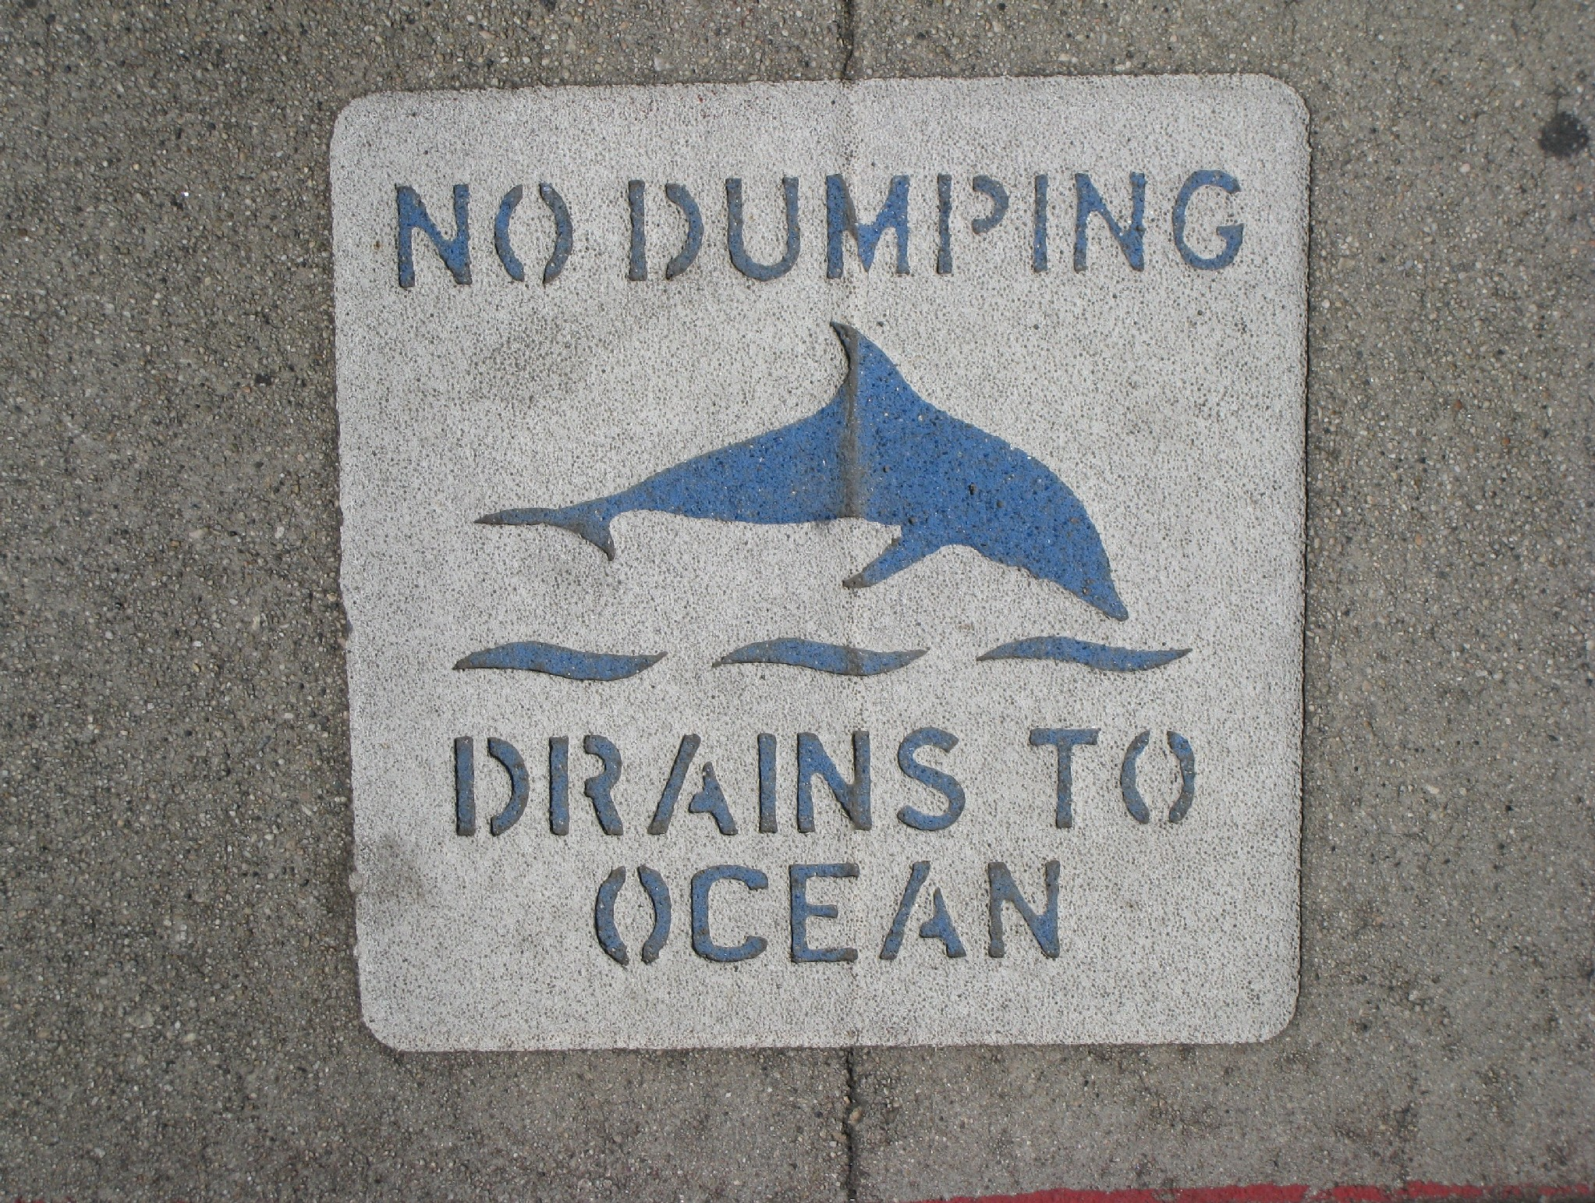
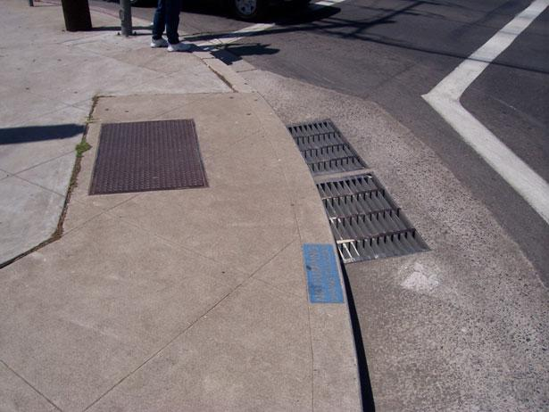
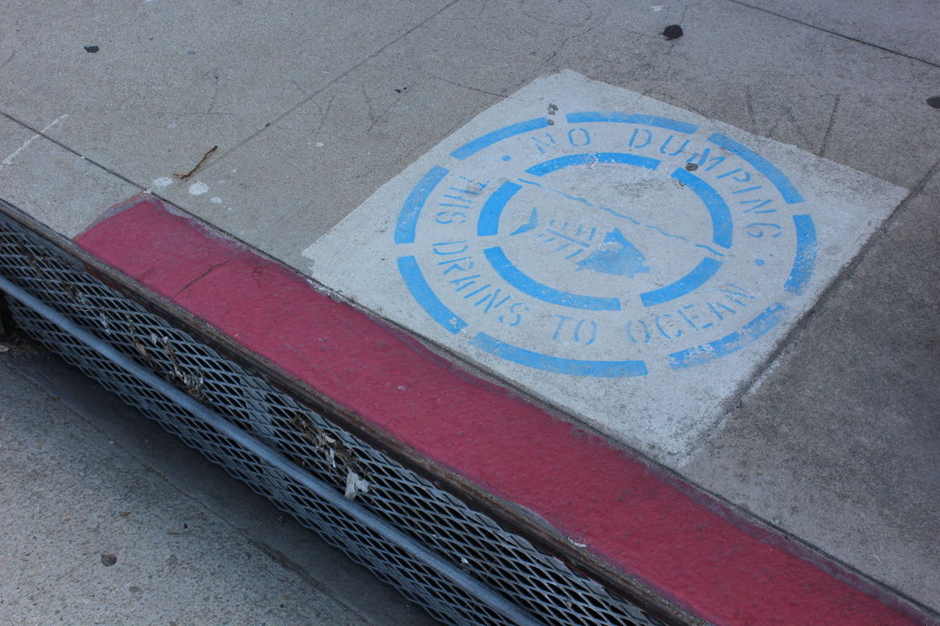
S13
Storm Drain Inlets
(also called
Catch Basins)
http://www.watereducation.org/aquafornia-news/innovative-ideas-southern-california-practical-projects-and-techniques-show-how
http://tbrnews.com/news/hermosa_beach/hermosa-beach-calls-on-community-to-help-stencil-storm-drains/article_263b58c6-ef90-11e4-b87c-53412c3a2f3c.html
http://www.kabbara.net/?page_id=468

Slide 14
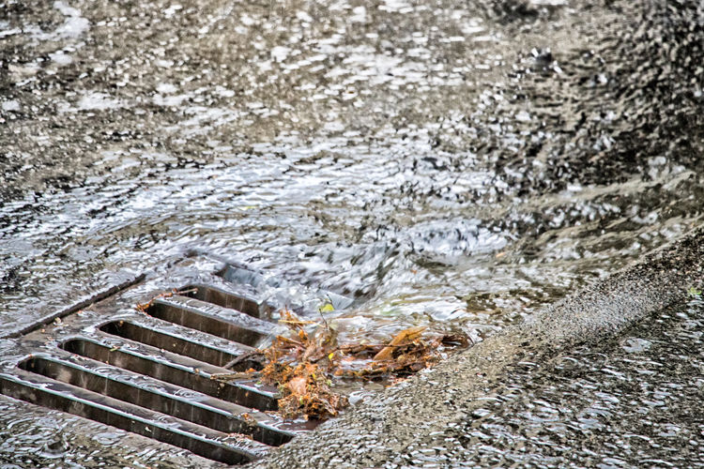
S14
RAINWATER IN CITY STREETS
Where does rainwater go to from the storm drain inlets or catch basins?
Where does it go to from creeks, streams and rivers? (Remember what we learned from the watershed model!)
https://kfiam640.iheart.com/content/2018-07-17-la-county-approves-stormwater-tax-for-november-ballot/#

Slide 15
S15
RAINWATER IN CITIES
What do you think happens to pollutants in our street when it rains?
Where do pollutants end up?
https://www.scpr.org/news/2018/07/17/84816/l-a-county-voters-to-decide-on-new-stormwater-tax/

Slide 16
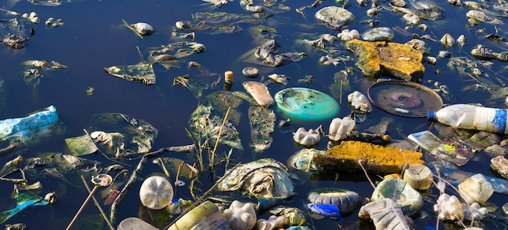
WHAT IS STORMWATER POLLUTION?
Excess water that runs down
storm drain inlets (or catch basins) carrying
pollutants from the environment.
S16
Credit: iStockphoto
https://www.doityourself.com/stry/what-are-the-effects-of-water-pollution-on-the-environment

Slide 17
ALL THE WAY TO THE OCEAN
S17
Notes:
Youtube video link: https://www.youtube.com/watch?time_continue=5&v=sZW2ByM623g

Slide 18
SCHOOL COMMUNITY FIELD TRIP
S18
We will take a field trip around our school.
Follow the directions in the map given to you.
Look for storm drain inlets (or catch basins) and mark them on your map with a blue checkmark.
Take note of any pollutants that can end up going down the storm drain inlets (or catch basins).
What do you think will happen to them?

Slide 19
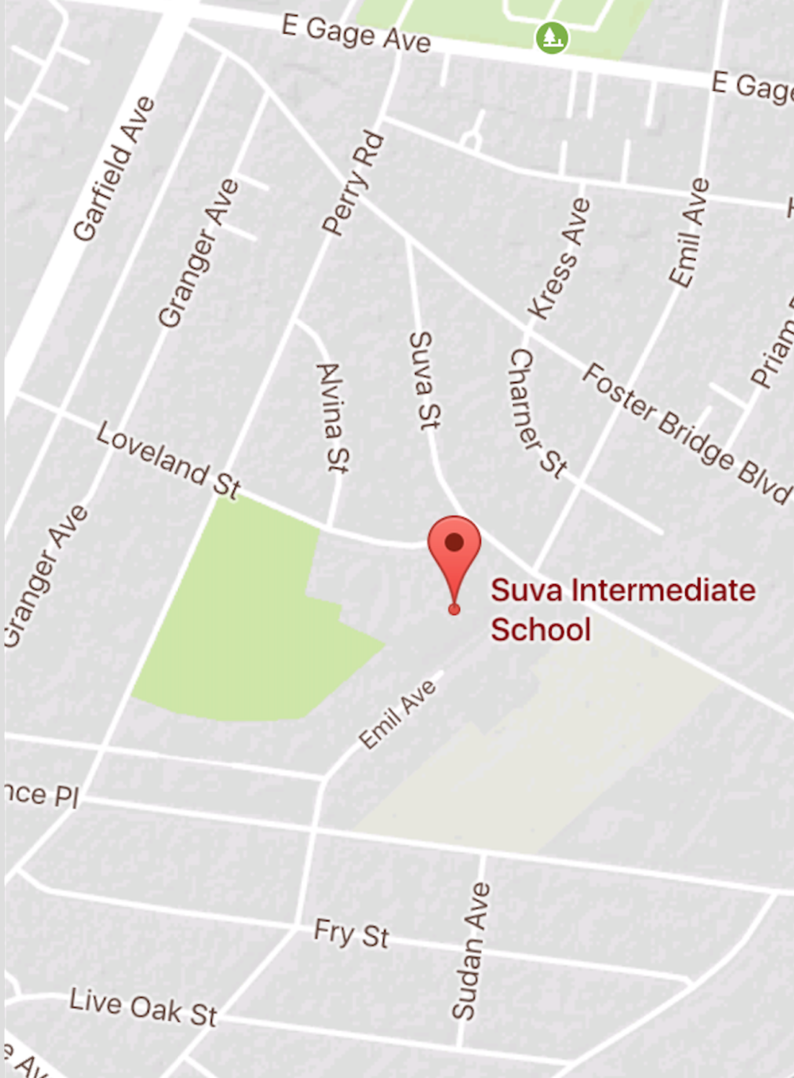
S8
FIELD TRIP MAP
KEY
Route and
direction
of field trip
Storm drain inlet (or catch basin)
location
SAMPLE

Slide 20
FIELD TRIP DISCUSSION QUESTIONS
How many storm drain inlets/catch basins did we see?
What types of waste or pollutants did you notice on our streets?
What do you think will happen to all the waste we found?
S20

Slide 21
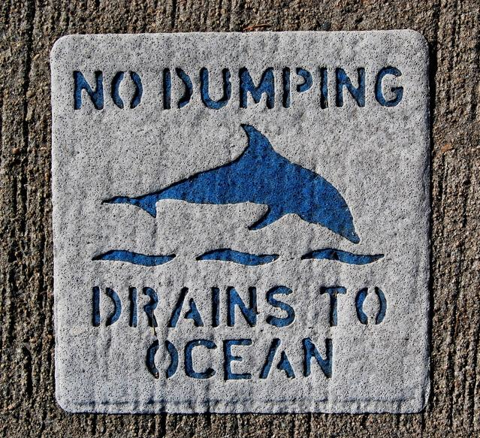
PUBLIC SERVICE ANNOUNCEMENT:
“How to Prevent Stormwater Pollution”
With a group, write a letter, draw a poster or put on a play
that will raise community awareness about keeping the
streets clean so water pollution doesn’t happen.
S21
https://www.freeimages.com/photo/ecology-2-1309067

