Slide 1
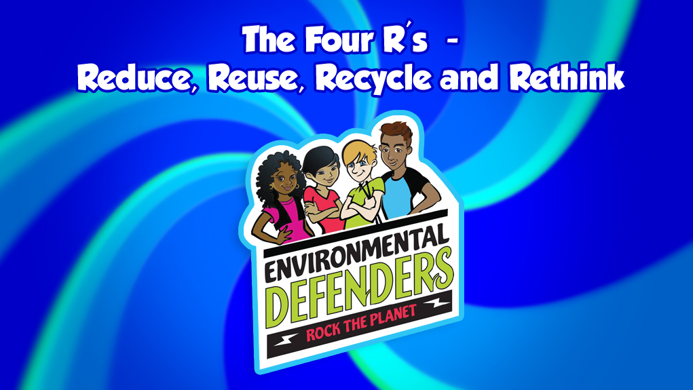
S1
© Copyright 2018, Los Angeles County.
All Rights Reserved.

Slide 2
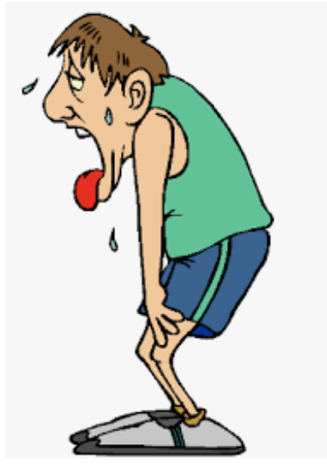
S2
What do you do if you’re thirsty?
http://vampirediaries.wikia.com/wiki/File:Tired-man.png

Slide 3
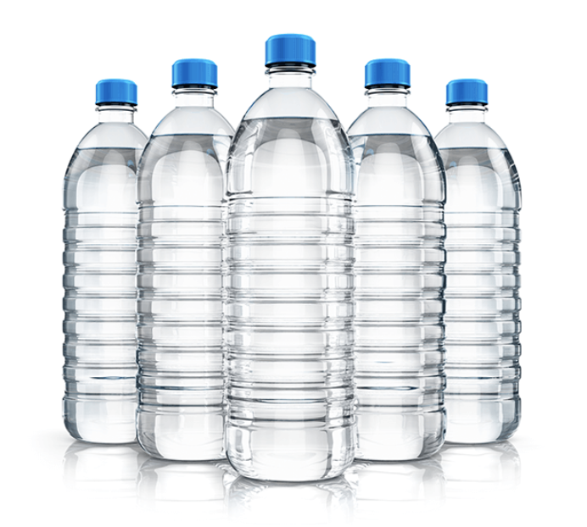
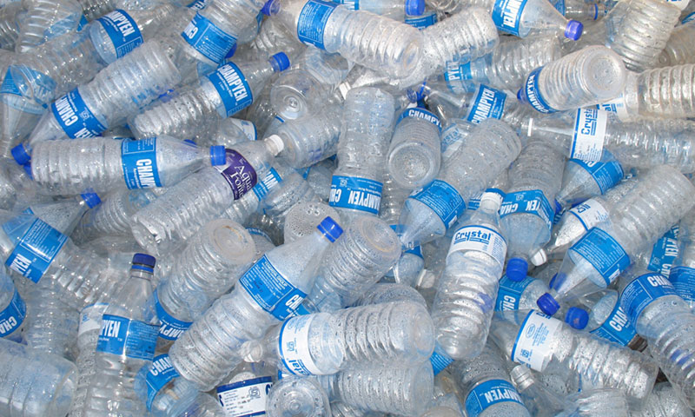
What happens to the empty bottles?
S3
https://thatbiologist.wordpress.com/2017/11/24/the-little-things-water-bottles/
http://www.healthyhopes.org/healthy-lifestyle/why-choose-bpa-free-water-bottles/

Slide 4
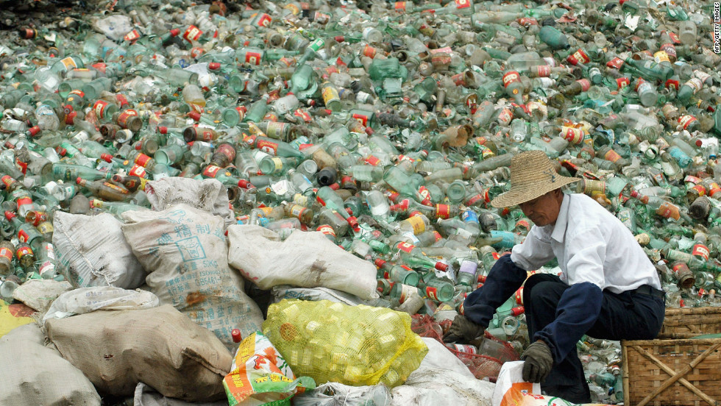
What do you think now?
S4
https://cdn.cnn.com/cnnnext/dam/assets/120423050340-china-landfill-horizontal-large-gallery.jpg

Slide 5
What do you think happens to other waste? What do you think we do with all the waste humans make?
S5

Slide 6
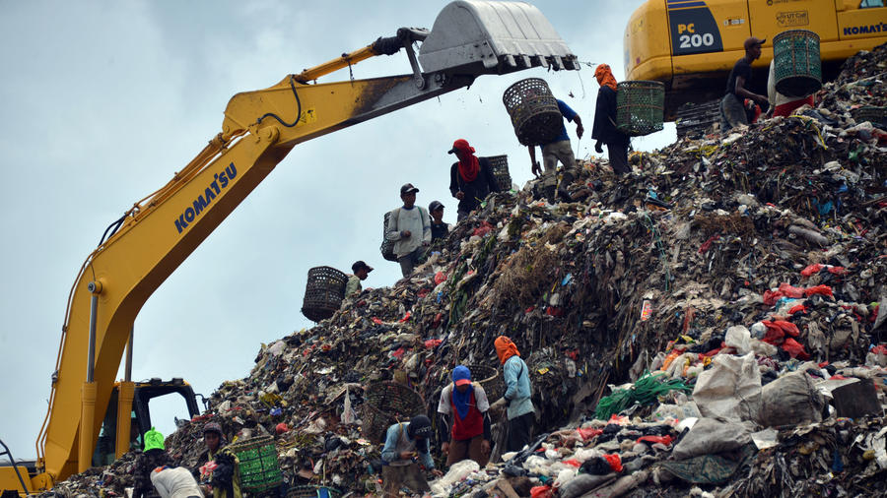
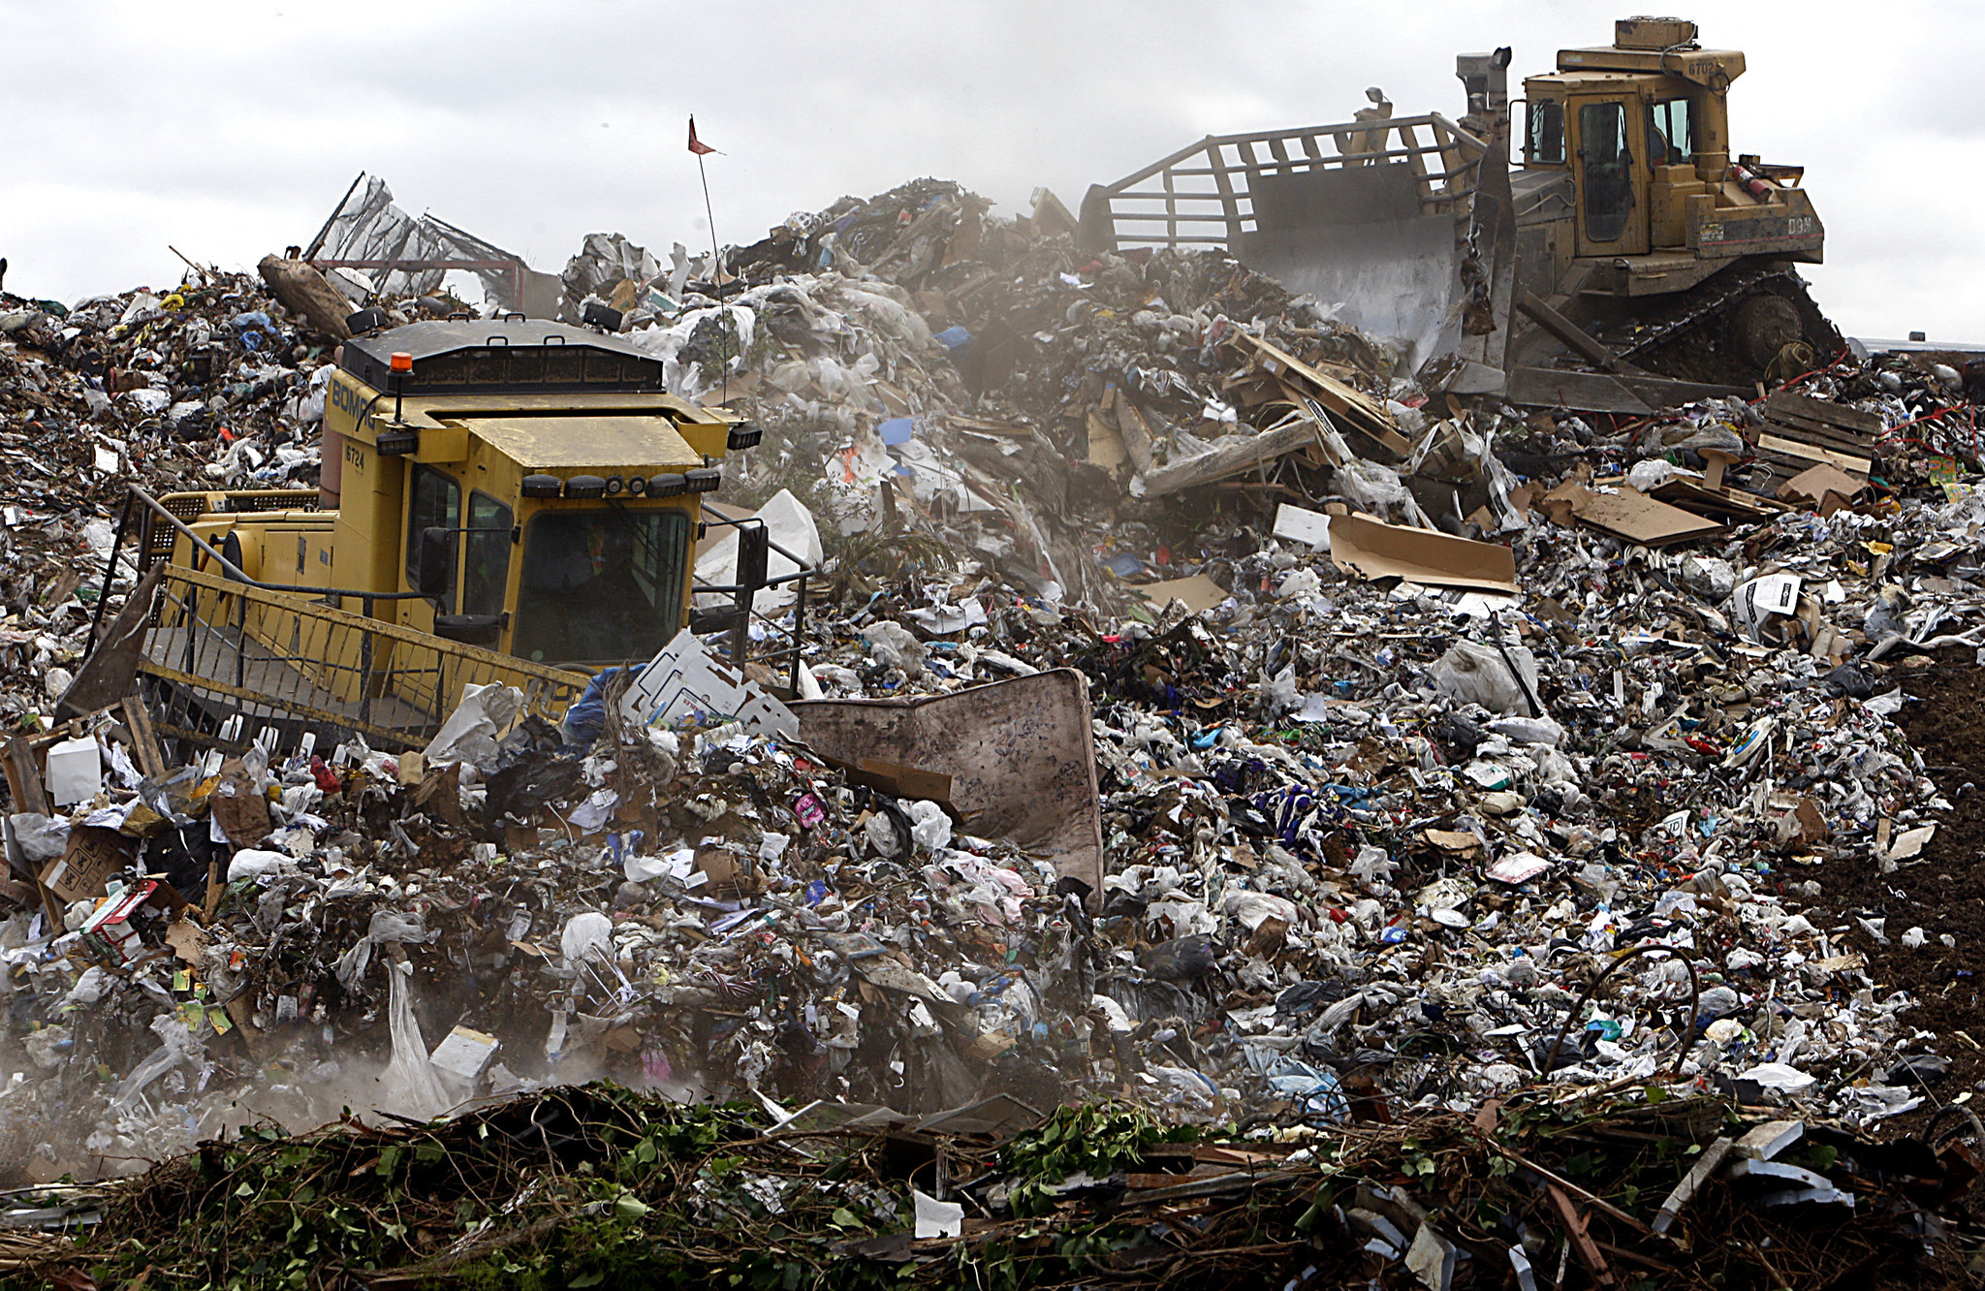
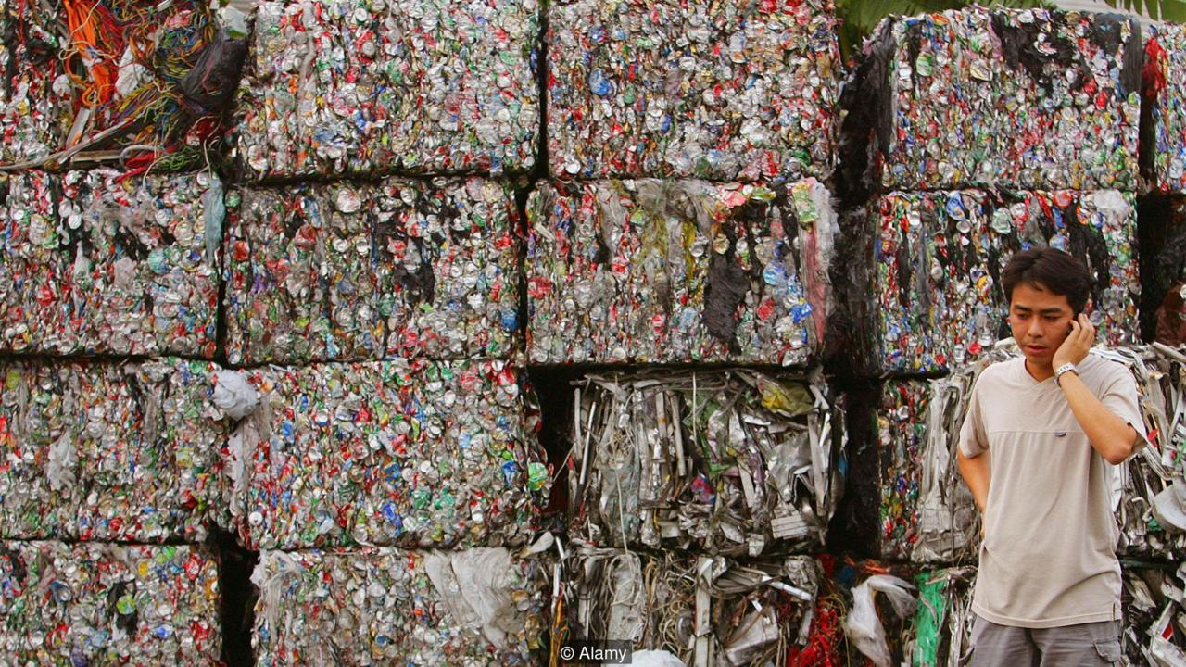
S6
http://www.latimes.com/world/global-development/la-fg-global-trash-20160422-20160421-snap-htmlstory.html
http://www.latimes.com/world/global-development/la-fg-global-trash-20160422-20160421-snap-htmlstory.html
http://www.bbc.com/future/story/20170427-hong-kong-has-a-monumental-waste-problem

Slide 7
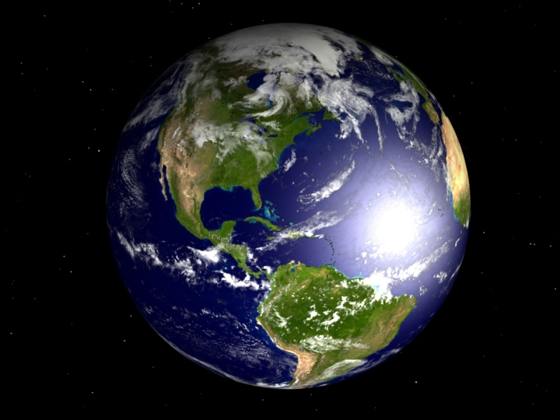
S7
What is this?
What is the name of our planet?
https://technoking.deviantart.com/art/The-Planet-Earth-87216225

Slide 8
CONSERVATION: Protecting our planet by decreasing the amount of waste produced by humans.
S8

Slide 9
Why is it important that we PROTECT and CONSERVE our planet?
S9

Slide 10
What do you think you can do to help decrease how much waste humans make?
S10

Slide 11
REDUCE AND REUSE
S11

Slide 12
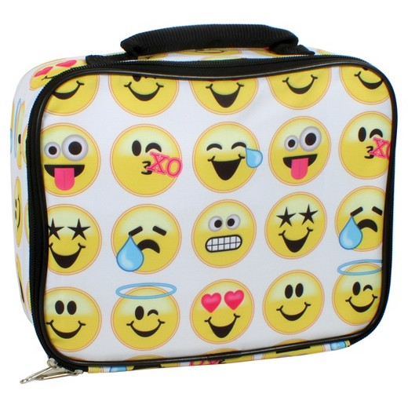
REDUCING AND REUSING
S12

Slide 13
REDUCE: Decreasing the amount of waste we produce.
REUSE: Using items that can be used more than once to reduce the amount of waste produced.
S13

Slide 14
With your group, think of other examples of reducing waste and reusing other materials instead.
S14

Slide 15
How does RETHINKING your choices by REDUCING and REUSING items help to conserve of our planet?
S15

Slide 16
RECYCLE
S16

Slide 17
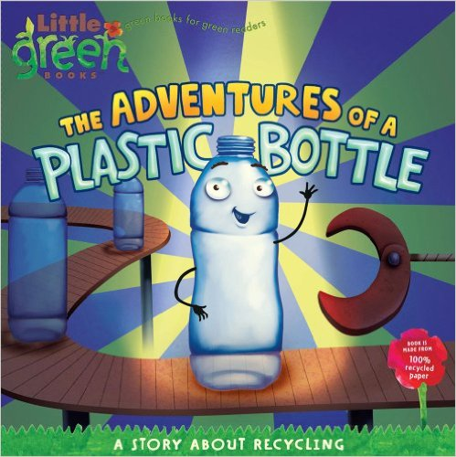
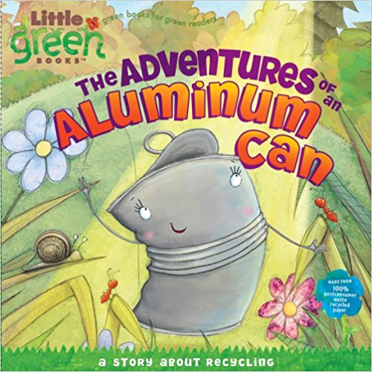
S17

Slide 18
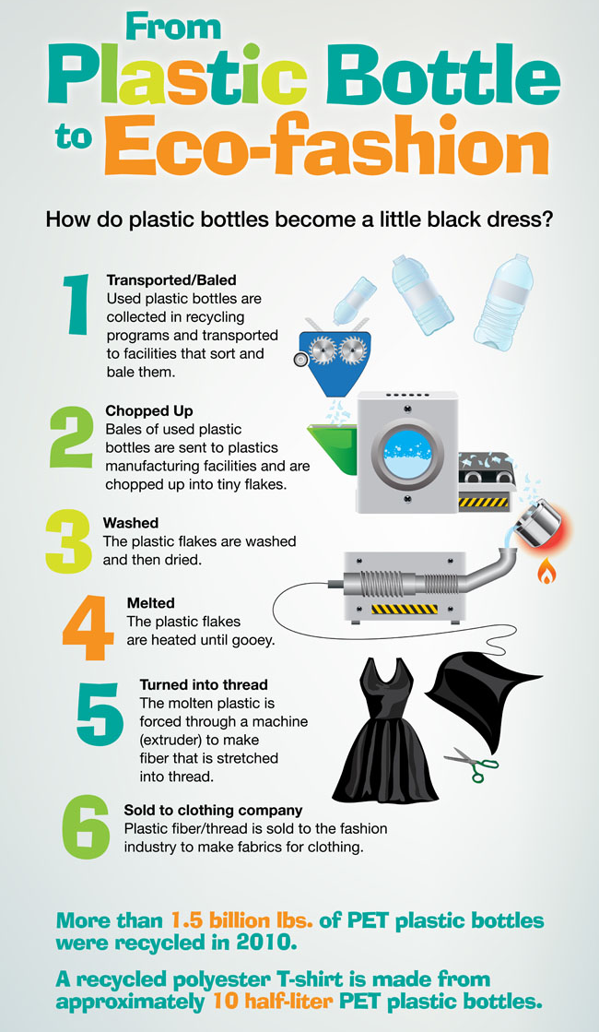
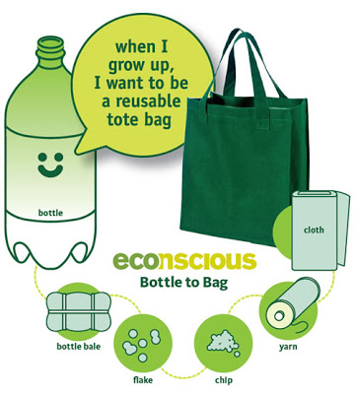
THE RECYCLING PROCESS
S18
http://www.creativegraphs.net/plastic-bottle-to-eco-fashion-facts.html
http://recycledfiberapparel.blogspot.com/2009/02/econscious-soda-bottle-recycling.html

Slide 19
How does RECYCLING items help conserve our planet?
S19

Slide 20
RECYCLE: The process of collecting and processing materials that would otherwise be thrown away as waste and turning them into new products.
S20

Slide 21
WHAT IS YOUR ACTION PLAN?
S21
How would you start reducing your waste production at home? At school? In your community or city?
How would you start reusing materials at home so you don’t add to waste? At school? In your community or city?
Make a list of items that you can start recycling at home. At school? In your community or city?

Slide 22
How does RETHINKING your choices by REDUCING, REUSING and RECYCLING items help conserve our planet?
S22

